Slide 1
CEBD1261(version 2.0) Final
Luciana Palucci
&
Jamie McKeown

Slide 2
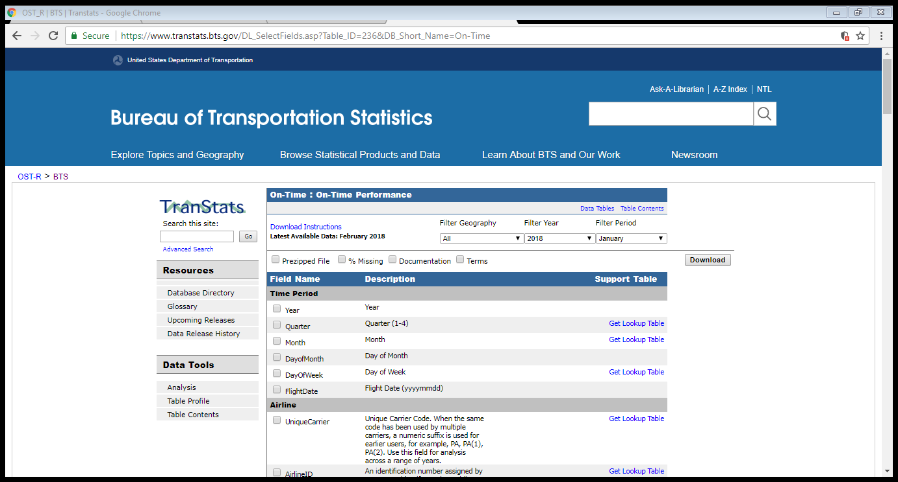
CEBD1261
Dataset origins: Bureau of Transportation Statistics Link

Slide 3
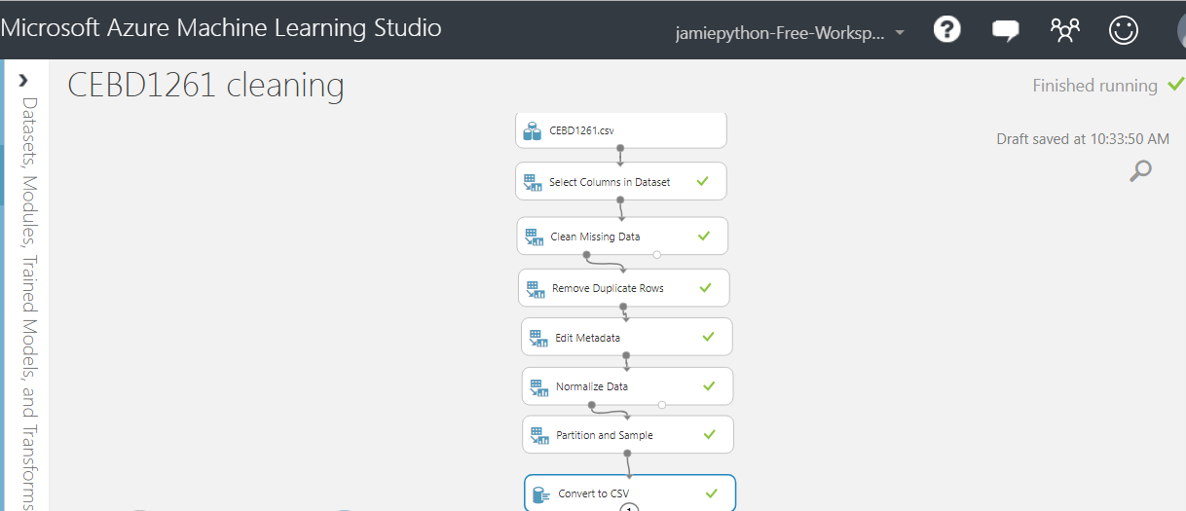
CEBD1261

Slide 4
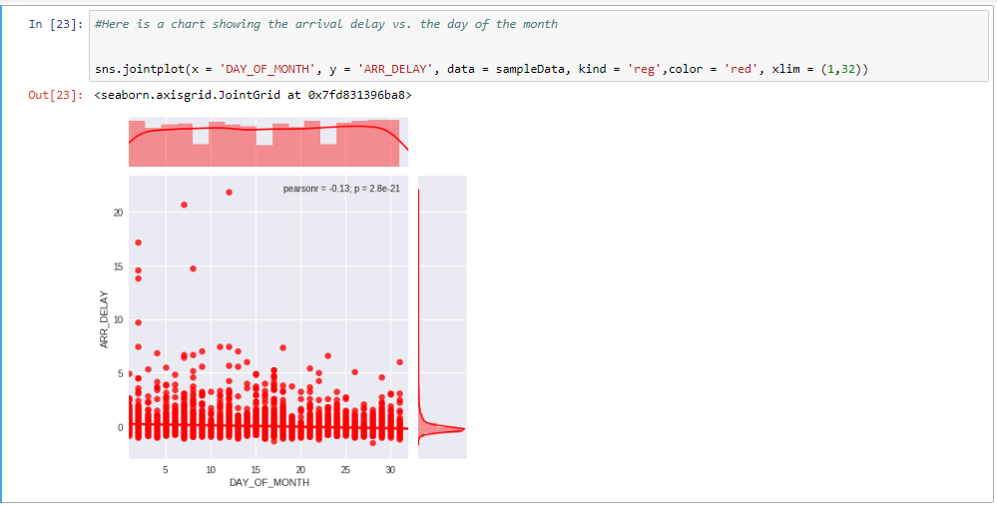
CEBD1261

Slide 5
CEBD1261
Sampling use case:
Using Azure ML Studio
We decided to use Microsoft Azure ML studio to do the data cleansing. Using this SaaS really saves a lot of time and allowed us to create a sample ( In the “Partition and Sample” module). The output was a clean csv file with 5510 rows.
After cleansing and isolating the sample, I simply verified the % of flights that were early or on-time. ( 3826/5510 = 69% )

Slide 6
CEBD1261
Big Data Use Case
An app that predicts in real time whether the flight you are trying to book will arrive early, on time, or LATE… ☹

Slide 7
CEBD1261
How:
Create a Linear Regression model using Machine Learning to predict if a flight will be early, on-time or late.
Once model is created we will use the flight details from the travel site as input for our model and send back a “pop-up” to the user telling them our prediction for that flight.

Slide 8
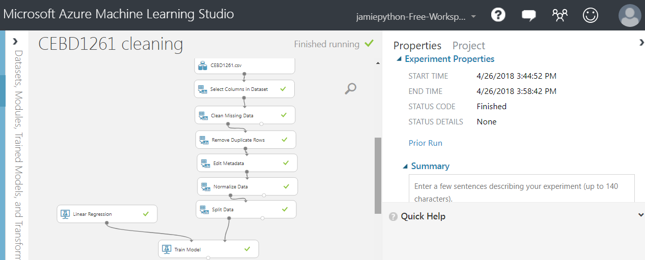
CEBD1261
Setting up Machine Learning algorithm to predict the delay time for specific flights
To be noted in below slide : RUN TIME was 14 minutes to train my model

Slide 9
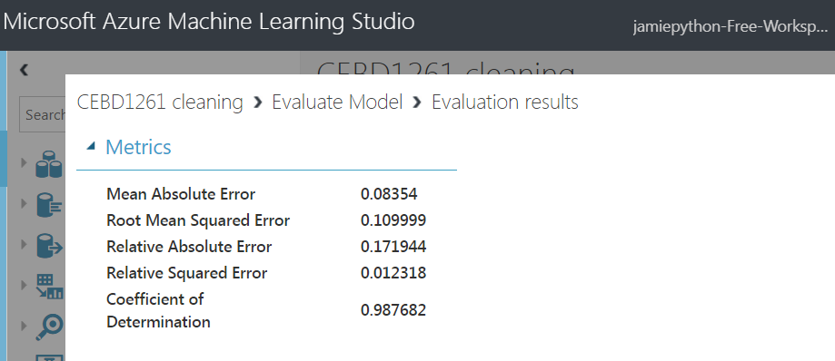
CEBD1261

Slide 10
CEBD1261
Why is this a big data problem???
Due to us needing to convert the data being entered ( the users flight preference converted to a format that is fed in to our model) in almost real-time we need to leverage big data and have our model run at scale as to provide response within a certain delay.

Slide 11
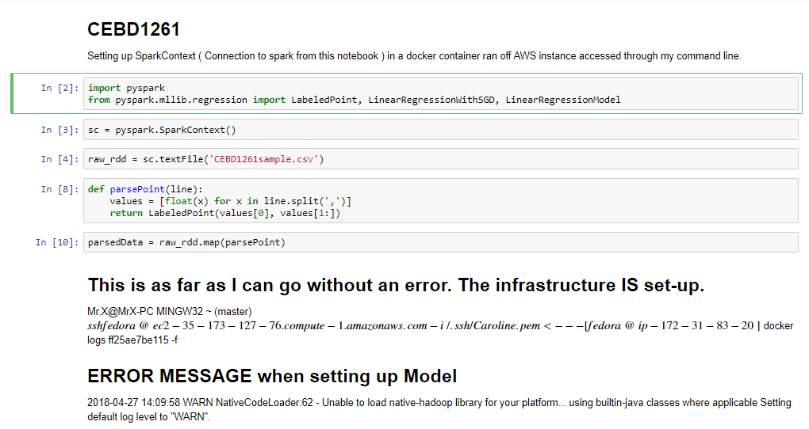
CEBD1261

Slide 12
CEBD1261
Big Data Use Case #2
An application showing real time flight departures by timepoint for all airports in a state or country.

Slide 13
CEBD1261
How:
Create an interactive chart in R to visualize the data and features hovering the mouse over data points for flight information, and selecting the axis timepoints.

Slide 14
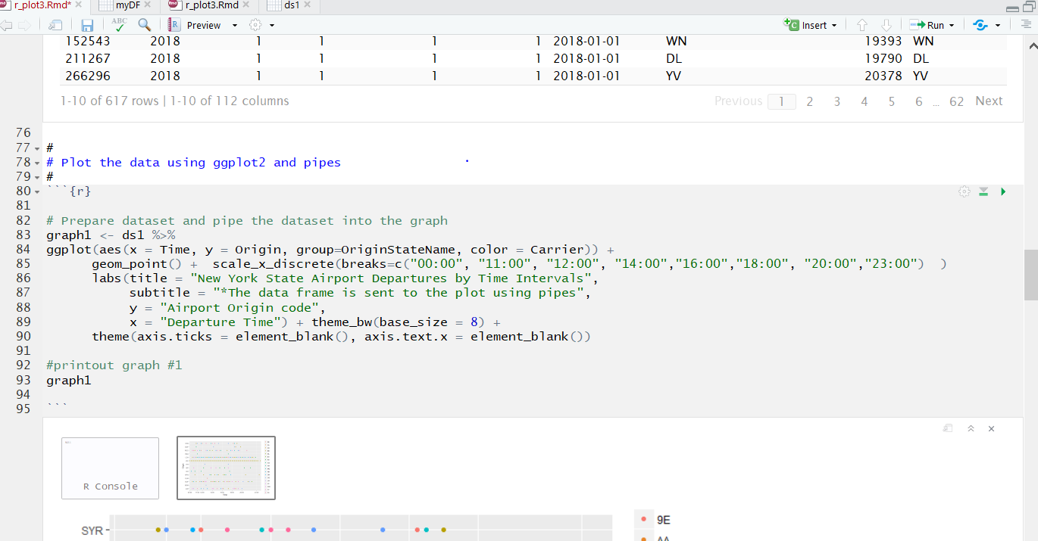
CEBD1261

Slide 15
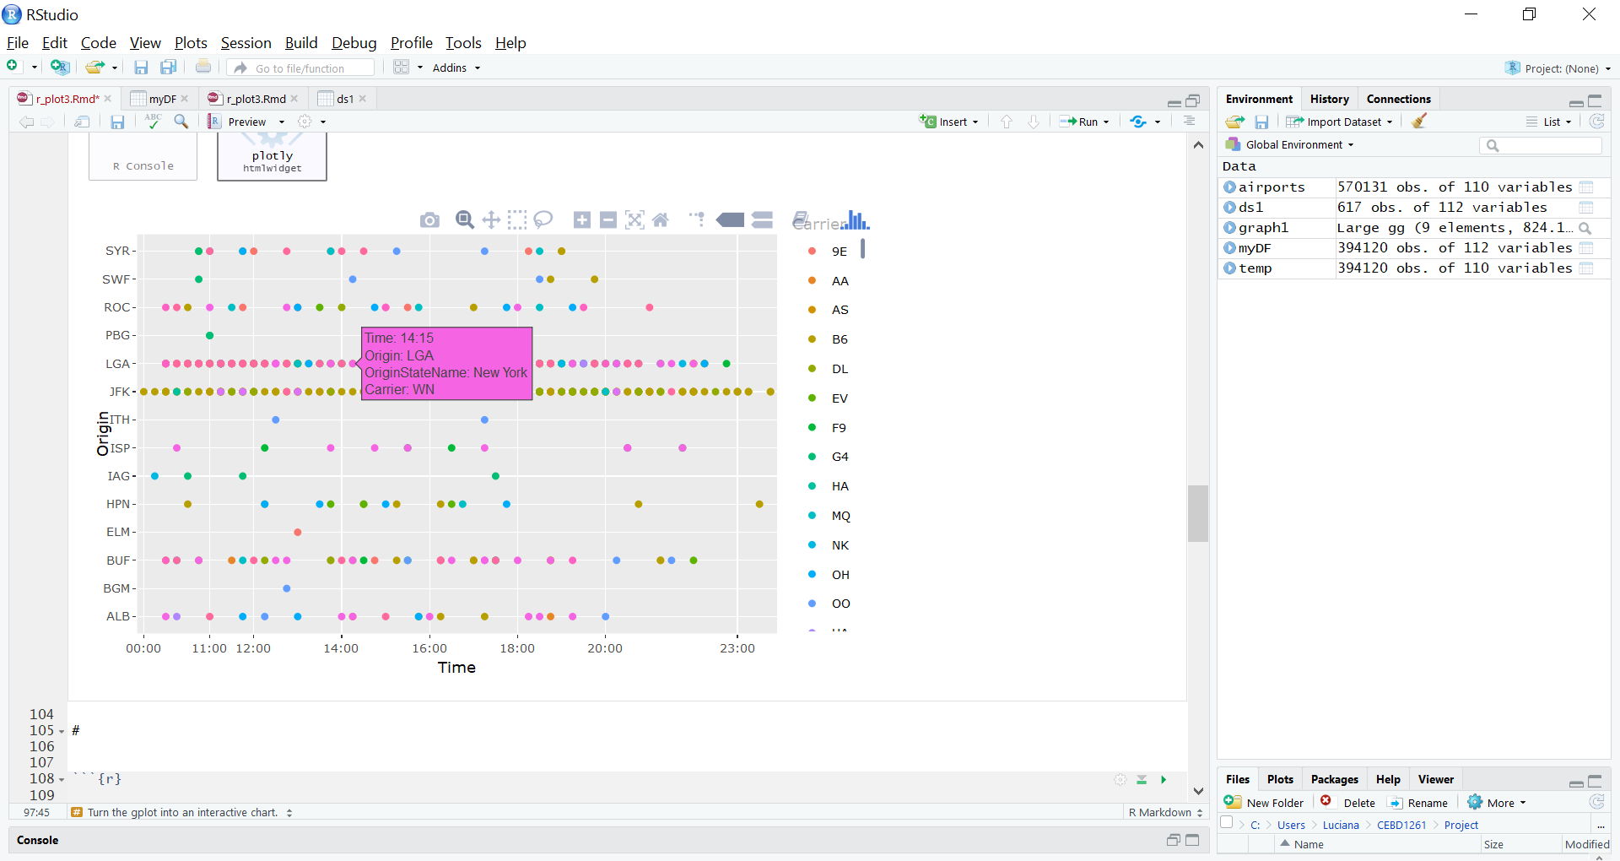
CEBD1261

Slide 16
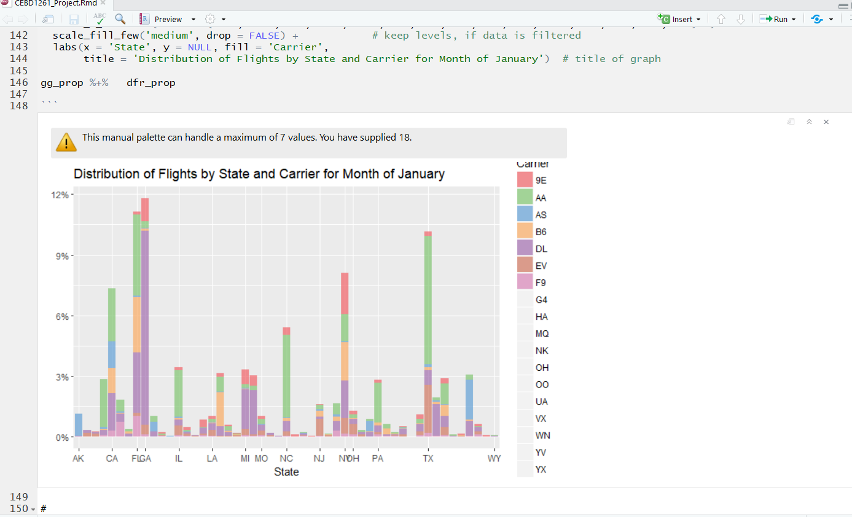
CEBD1261
Sampling use case:
Distribution by State and Origin City of Airport Departures by Carrier

Slide 17
CEBD1261
Questions???

